Slide 1
Identifying Metabolic Regulators of Human Stem Cell Differentiation using Machine Learning
Cameron Mirhossaini
Jason Cosgrove and Leïla Périe
L’Institut Curie
Paris, France

Slide 2

About Me
BS: Mathematical and Computational Science
”Liberal Arts for Mathematics”
Background in Statistics, Computer Science, and Mathematics
Applications to Sociology and Biology
Personal Life
Runner
Interested in Botany and Astronomy,

Slide 3


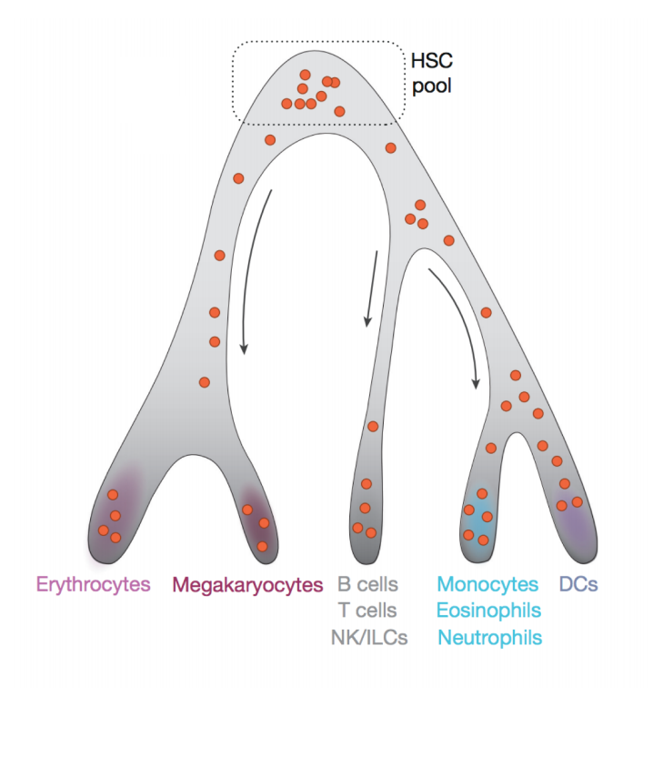
Outline for Today
Define our problem
Processing: Data
Application: Machine Learning / Filtering
Gene Output + Code Sample
Conclusions/Discussion
Henry the Hematopoietic Lineage Tree

Slide 4
Outline for Today
Define our problem
Processing: Data
Application: Machine Learning / Filtering
Gene Output
Conclusions/Discussion

Slide 5
Defining our problem
Hematopoiesis is the process by which hematopoietic stem and progenitor cells (HSPCs) give rise to all blood cell types.
Interested in predicting the lineage bias of early progenitor cells
Important because many diseases arise from abnormal ratios in blood cells (leukemia)
Sender R, Fuchs S, Milo R. PLOS Biology (2016); Laurenti, E. et al., Nature (2018)

Slide 6
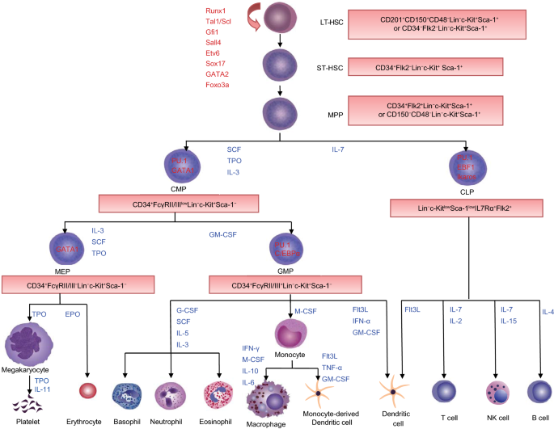

Slide 7
Hypothesis
Metabolism is a key regulator in Hematopoietic stem cell differentiation in humans
Notes:
If a metabolic pathway gave rise to lineages, there would be some genes that relate only to specific lineages evident early on (correlative)

Slide 8
Outline for Today
Define our problem
Processing: Data
Application: Machine Learning / Filtering
Gene Output
Conclusions/Discussion

Slide 9
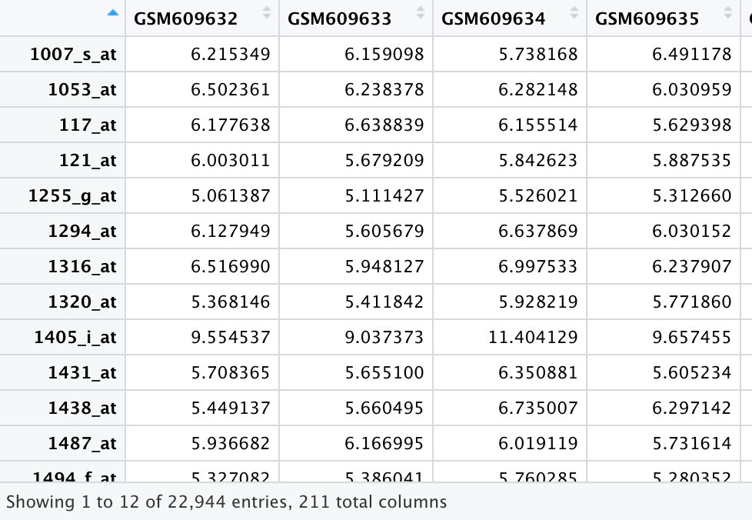

Slide 10
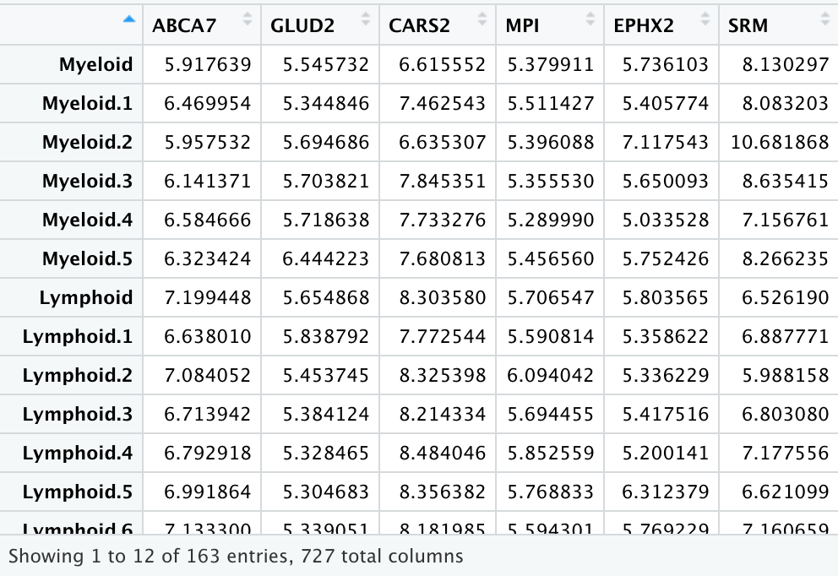

Slide 11
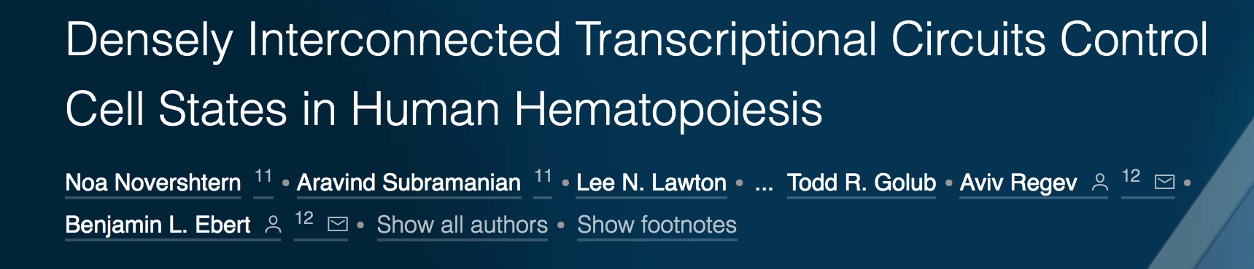
Source of Data
211 sample cells collected from umbilical cord blood and peripheral blood via multiparameter flow cytometry (22,944 genes)
Isolated mRNA from each cell type and measured expression profiles using Affymatrix microarrays (light intensity)
Human umbilical cord blood harvested from postpartum placentas at Brigham and Women's Hospital under an IRB-approved protocol
Majority came from human umbilical chord blood
Terminally differentiated lymphocyte populations (T cells, B cells, natural killer cells, and dendritic cells) came from adult peripheral blood because they require exposure to antigens after birth

Slide 12
Normalization of DMAP data
ComBat method used to reduce batch effects
Applies empirical Bayes framework for adjusting data for batch effects
Handles unwanted variation across batches
Transcript levels processed via RMA method
Corrects for non-biological sample variation using quantile normalization
Handles unwanted variation within one batch
NA values?
Row/Column names, transpose
Relevant Cell Types + Metabolic Genes
Notes:
Explain what combat does and why

Slide 13
ComBat Method
From Bioconductor package sva
Batch effects- technical sources of variation that have been added to samples during handling from different batches, or sets, of data
Location and scale parameters, representing mean and variance, are estimated for each batch and each gene independently
Batch effects are estimated by empirical Bayes and used for batch effect removal
Removing Batch Effects from Longitudinal Gene Expression - Quantile Normalization Plus ComBat as Best Approach for Microarray Transcriptome Data attests to ComBat’s success in reducing batch effects and maintaining biological variability

Slide 14
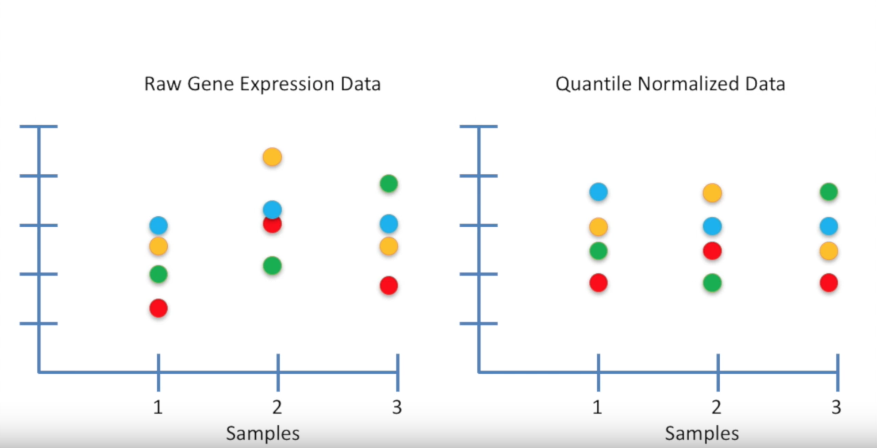
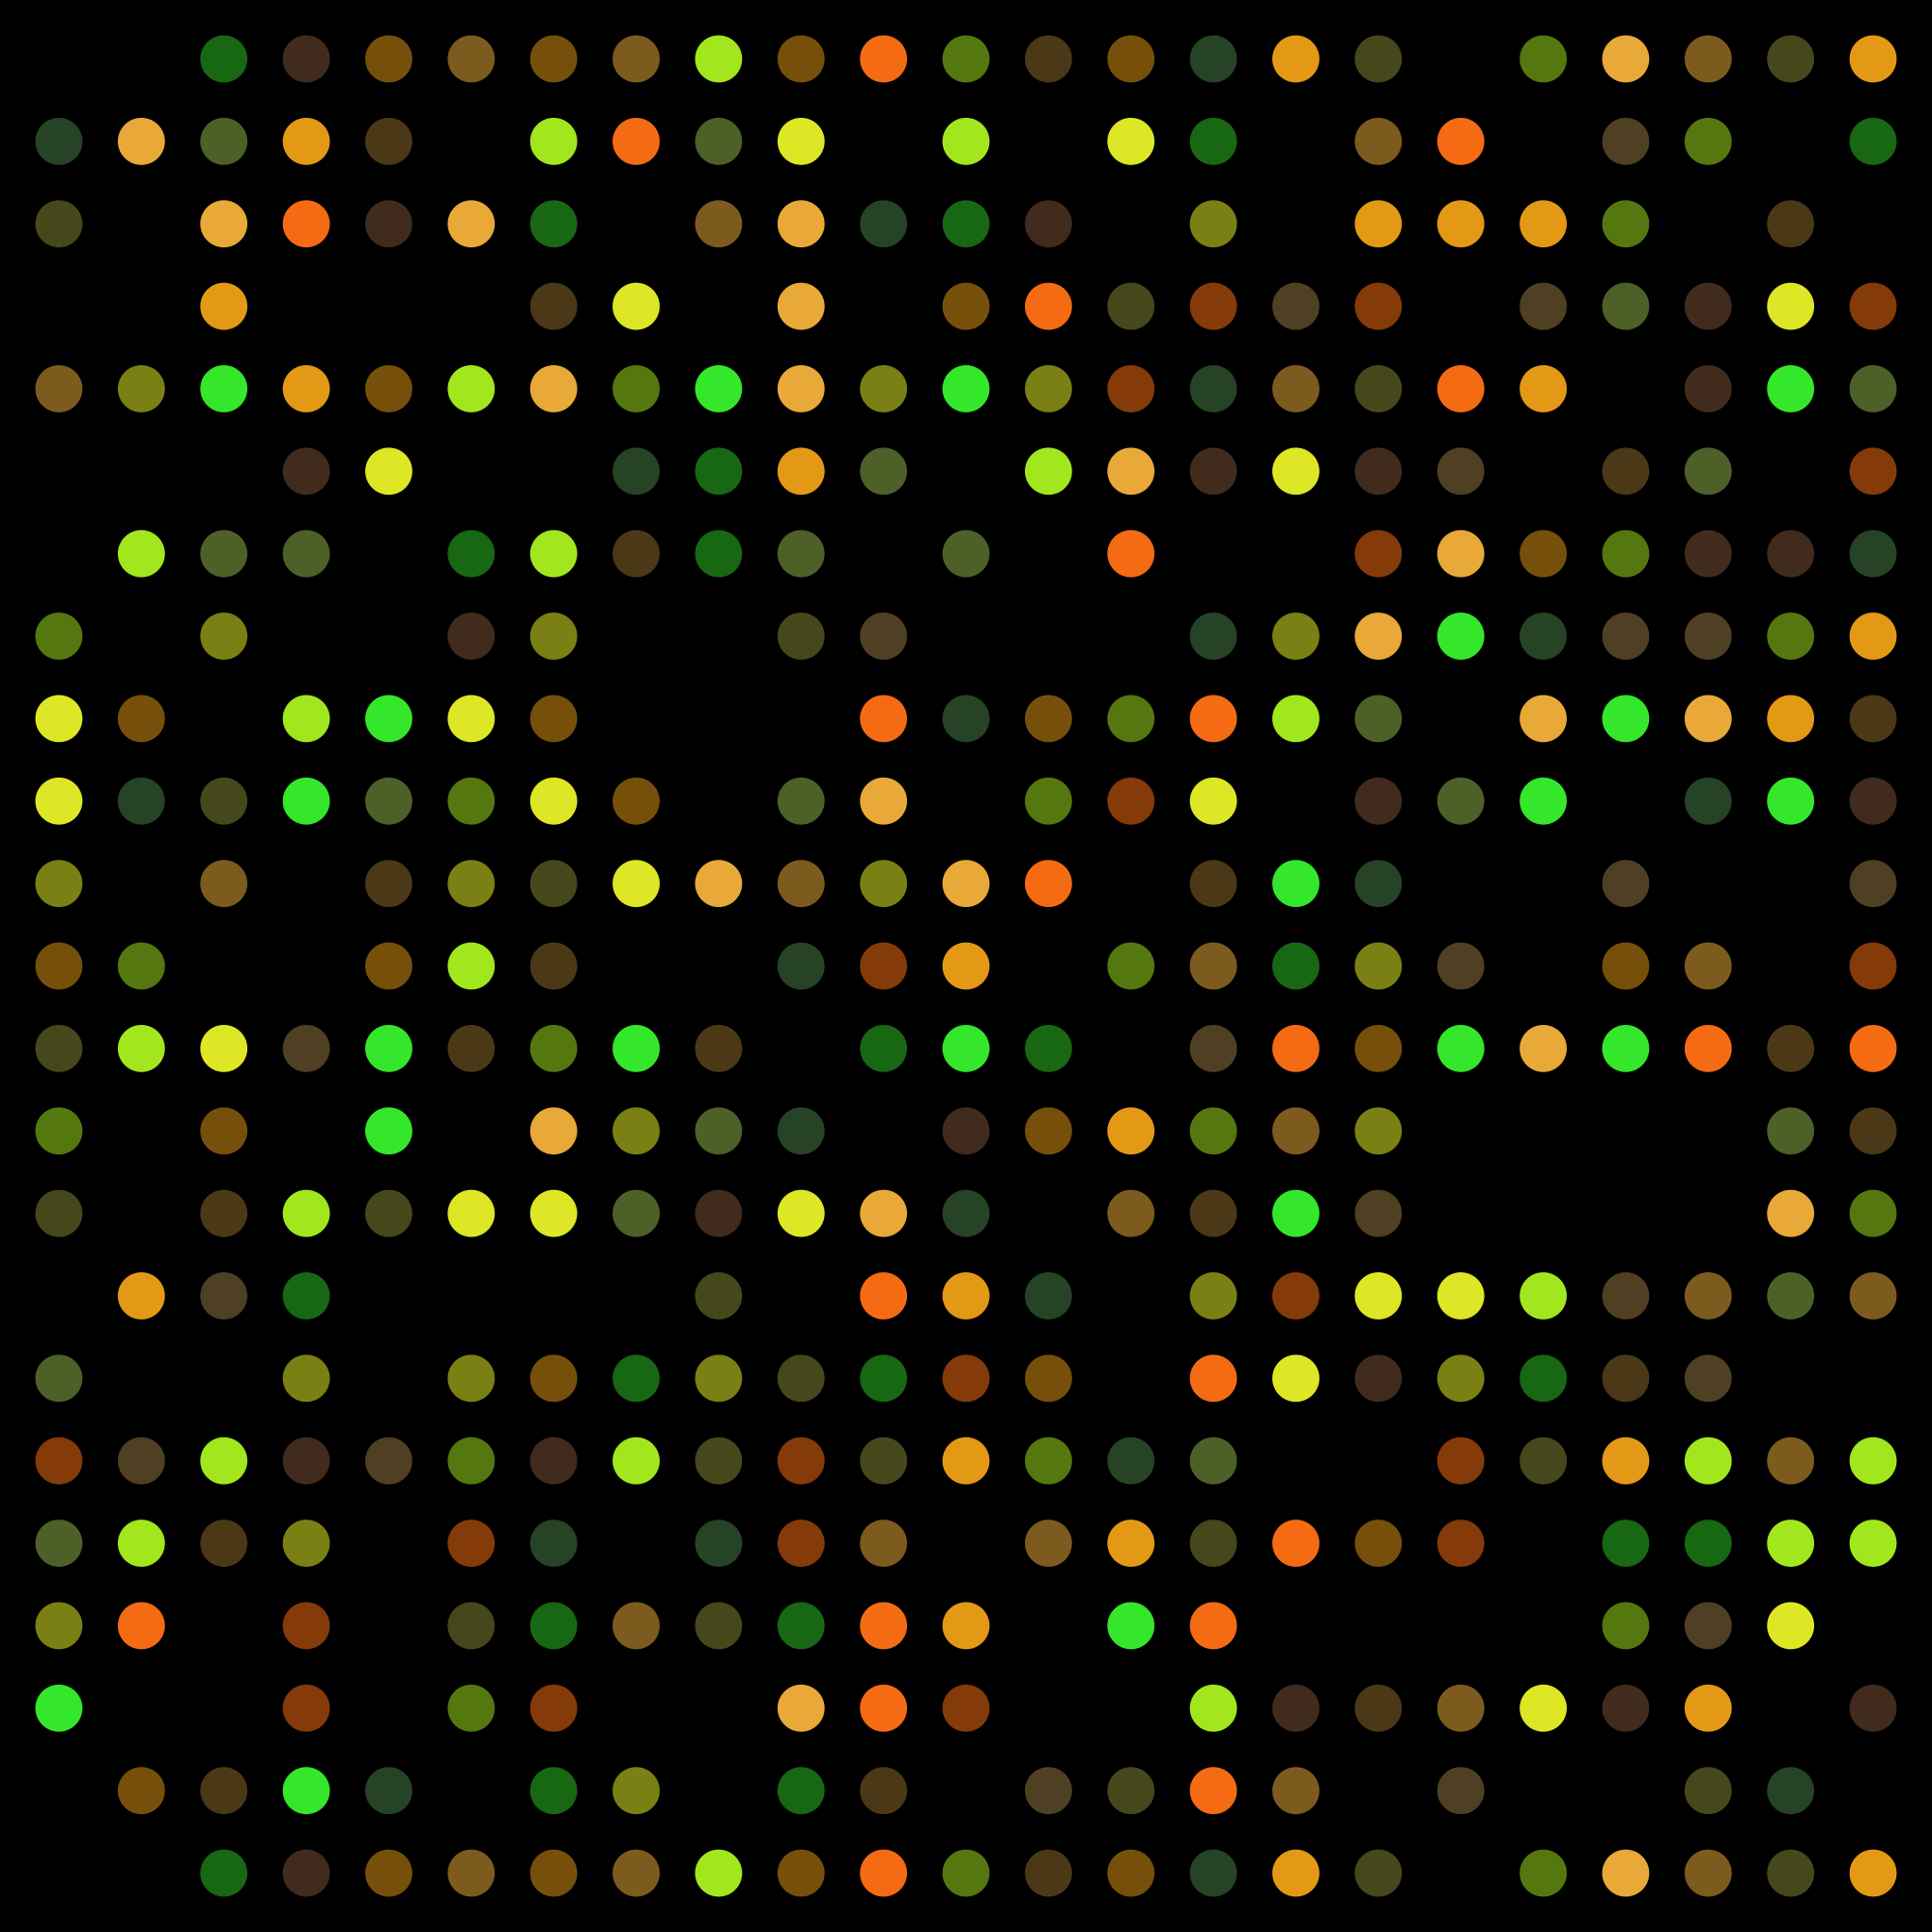
Robust Multi-array Average (RMA) Normalization
Background Correction
Removes peripheral intensities not from probe itself
Assign spot intensity after subtracting for background intensity
Report median/mean pixel intensity for each sample
Log₂ transform, mean = 0
Standardizes and normalizes data
Quantile normalization
Focus in most highly expressed gene in each sample
Calculate mean of this gene
Quantile-normalized value for genes with highest expression is their mean value in new plot
Repeat for each gene in all probes
Needed because
Interesting Variation vs. Obscuring Variation
Interesting Variation: differences between diseased tissue and healthy tissue
Obscuring Variation: manufacturing, processing (labeling, hybridization, scanning) of arrays
Source: An Introduction to Microarray Data Analysis Source: Exploration, normalization, and summaries of high density oligonucleotide array probe level data

Slide 15
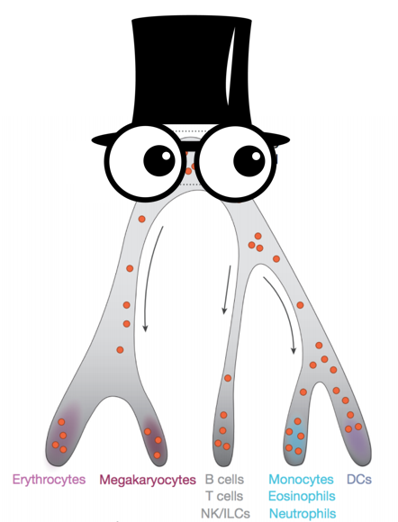
Upshot
Data is messy
All experimentation will have some error
Mathematics is a (off-the-cuff) way of handling inherent disorder
Henry is a complex being and numbers only aim to simplify his complexity

Slide 16
Outline for Today
Define our problem
Processing: Data
Application: Machine Learning
Filtering
Gene Output
Conclusions/Discussion

Slide 17
Hypothesis
Metabolism is a key regulator in Hematopoietic stem cell differentiation in humans
If true, metabolic genes variation should correlate with lineage
Notes:
If a metabolic pathway gave rise to lineages, there would be some genes that relate only to specific lineages evident early on (correlative)

Slide 18
The Classification Problem
Progenitor Cell
Mature Cell prediction
Machine Learning Algorithm

Slide 19
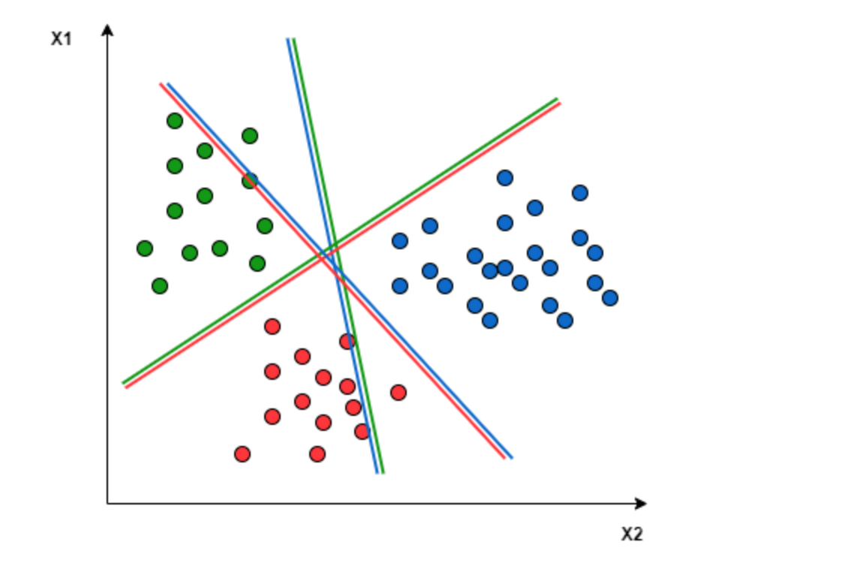
The Classification Problem

Slide 20
Supervised Learning
Mature Cell
Mature Cell
Create/Train model rules using mature cells (Henry’s feet)
Verify accuracy of model (how well did it do on cells known well?)
Train on Progenitor cells (or ideally, cells that a human would not be able to discern)
Gradient Boost
Notes:
Couple other ML algorithms we could have used—gradient boost fit the bill because multi-class classification, dependence between classes. Other options are native Bayes, k-means clustering

Slide 21
Supervised Learning
 | Erythroid | Lymphoid | Meg | Myeloid
Erythroid | 31 | 0 | 3 MEGA1.3 MEGA1.4 MEGA2.10 | 1 GRAN1.23
Lymphoid | 0 | 92 | 0 | 3 BASO1.2 BASO1.5 GRAN2.22
Meg | 1 ERY2.11 | 0 | 9 | 0
Myeloid | 1 ERY2.10 | 0 | 0 | 39
Create/Train model rules using mature cells (Henry’s feet)
Verify accuracy of model (how well did it do on cells known well?)
Train on Progenitor cells (or ideally, cells that a human would not be able to discern)
Notes:
Couple other ML algorithms we could have used—gradient boost fit the bill because multi-class classification, dependence between classes. Other options are native Bayes, k-means clustering

Slide 22
Supervised Learning
Progenitor Cell
Mature Cell prediction
Create/Train model rules using mature cells (Henry’s feet)
Verify accuracy of model (how well did it do on cells known well?)
Test on Progenitor cells (or ideally, cells that a human would not be able to discern)
Gradient Boost
Notes:
Couple other ML algorithms we could have used—gradient boost fit the bill because multi-class classification, dependence between classes. Other options are native Bayes, k-means clustering

Slide 23
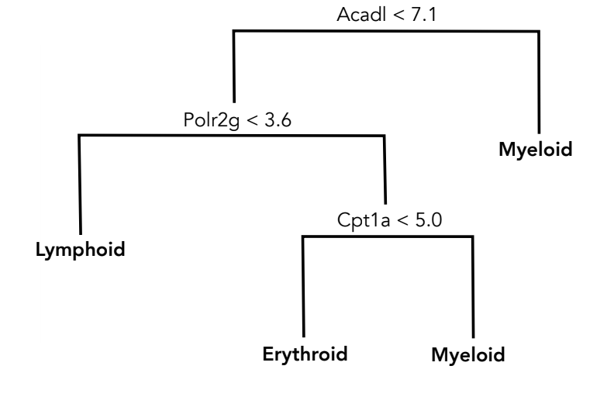
Gradient Boost

Slide 24
Training Data:

Slide 25
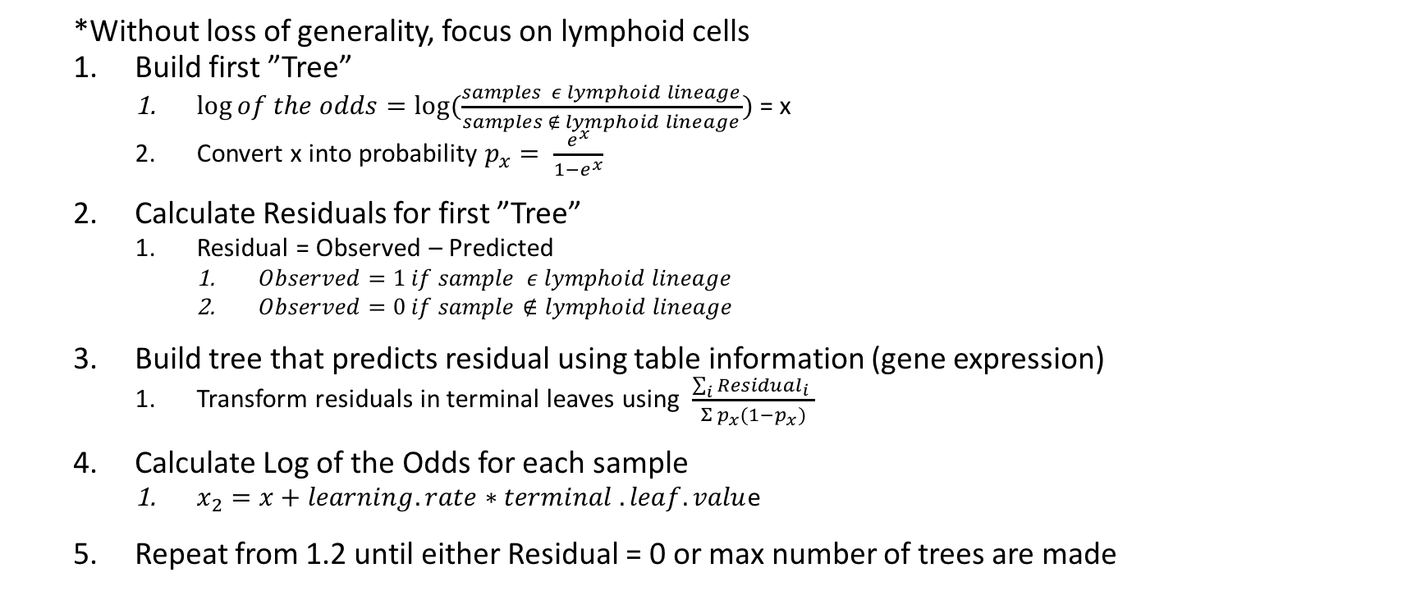
Gradient Boosting for Classification
*Without loss of generality, focus on lymphoid cells
Build first ”Tree”
$\log{of the odds=log⁡(\frac{samples ε lymphoid lineage}{samples ∉ lymphoid lineage})}$ = x
Convert x into probability $p_{x}= \frac{e^{x}}{1−e^{x}}$
Calculate Residuals for first ”Tree”
Residual = Observed – Predicted
$Observed=1 if sample ε lymphoid lineage$
$Observed=0 if sample∉lymphoid lineage$
Build tree that predicts residual using table information (gene expression)
Transform residuals in terminal leaves using $\frac{\sum_{i}{{Residual}_{i}} }{Σ p_{x}(1−p_{x})}$
Calculate Log of the Odds for each sample
$x_{2}=x+learning.rate∗terminal .leaf.valu$e
Repeat from 1.2 until either Residual = 0 or max number of trees are made
Notes:
Pseudo code

Slide 26
MC Area under the Curve: .8791
Confusion Matrix
True
 | Erythroid | Lymphoid | Meg | Myeloid
Erythroid | 32 | 0 | 3 | 1
Lymphoid | 0 | 91 | 0 | 6
Meg | 0 | 0 | 8 | 0
Myeloid | 1 | 1 | 1 | 36
Parameters:
Nfolds = 10
Nrounds = 16
Subsample = .8
Colsample_bytree= .5
Colsample_bynode = .5
megWeight = 2 (maybe)
Lambda = 1 (larger lambda makes more conservative)
Predicted
Notes:
Test people on understanding of this plot

Slide 27
Results on Progenitor Cells
True Cell Type | Algorithm Prediction
GMP | Myeloid | ✅
GMP | Myeloid | ✅
GMP | Myeloid | ✅
GMP | Erythroid | ⛔️
MEP | Erythroid | ✅
MEP | Erythroid | ✅
MEP | Erythroid | ✅
MEP | Erythroid | ✅
MEP | Erythroid | ✅
MEP | Erythroid | ✅
MEP | Erythroid | ✅
MEP | Erythroid | ✅
MEP | Erythroid | ✅
Notes:
Label figure better

Slide 28
Upshot
Supervised Machine Learning can predict which lineage a progenitor cell will fall into
There are mathematical differences between cell types
We used decision trees for our task, but there are many other types of classifiers (Bayes, k-means, logistic regression, SVM)
Our Confusion Matrix was not perfect on the training set, but the test on the progenitor cells went well

Slide 29
Outline for Today
Define our problem
Processing: Data
Application: Machine Learning
Filtering
Gene Output
Conclusions/Discussion

Slide 30
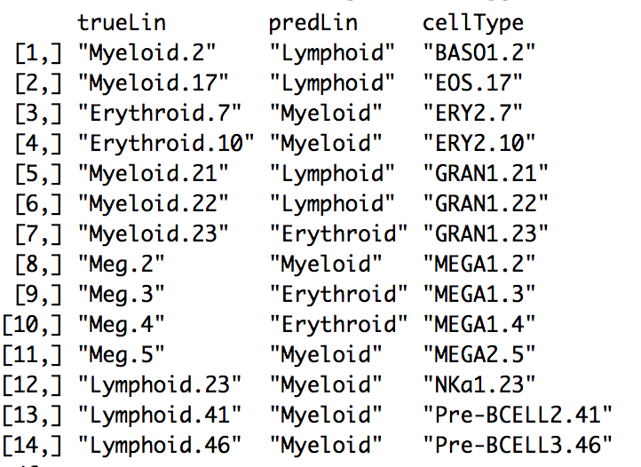
Metabolic Genes/No Filter *
 | Erythroid | Lymphoid | Meg | Myeloid
Erythroid | 31 | 0 | 2 MEGA1.3 MEGA1.4 | 1 GRAN1.23
Lymphoid | 0 | 89 | 0 | 4 GRAN1.21 GRAN2.22 BASO1.2 EOS.17
Meg | 0 | 0 | 8 | 0
Myeloid | 2 ERY2.7 ERY2.10 | 3 Nka1.23 Pre-BCELL2.41 Pre-BCELL2.46 | 2 MEGA1.2 MEGA2.5 | 38
AUC = .8854

Slide 31
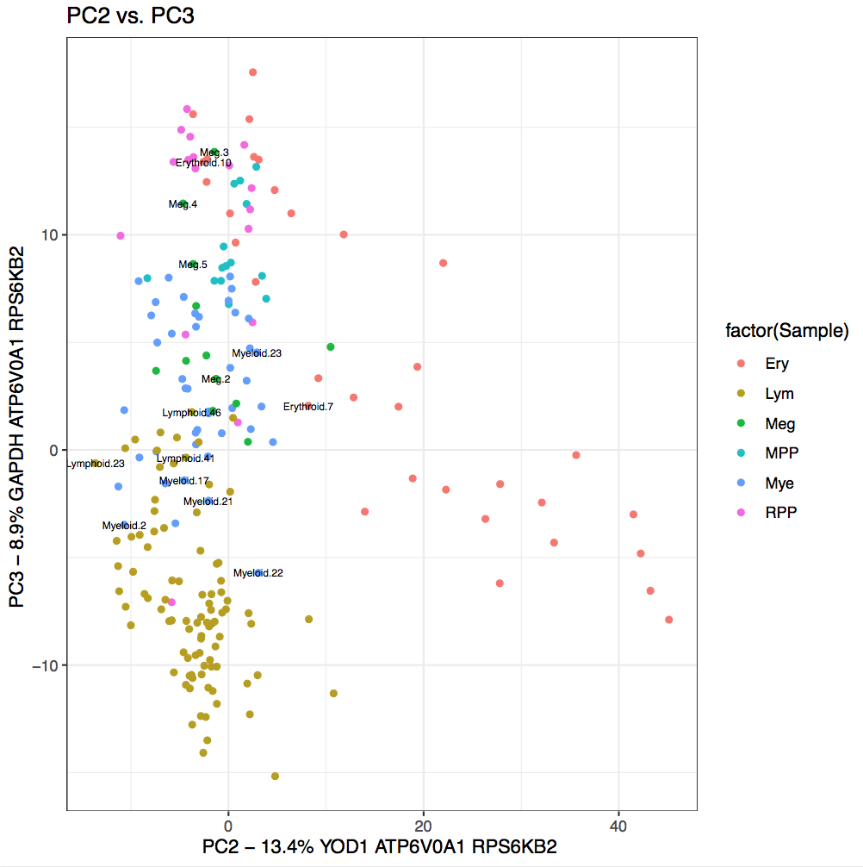
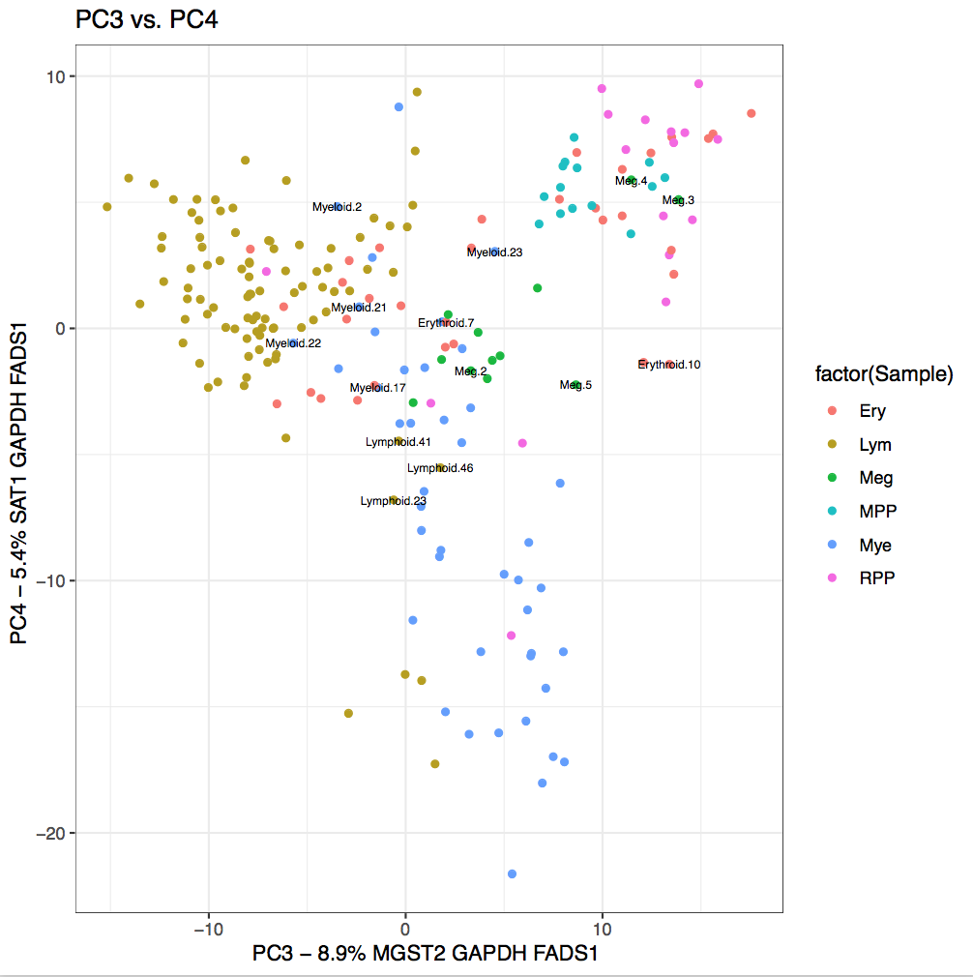

Slide 32
In the end…

Slide 33
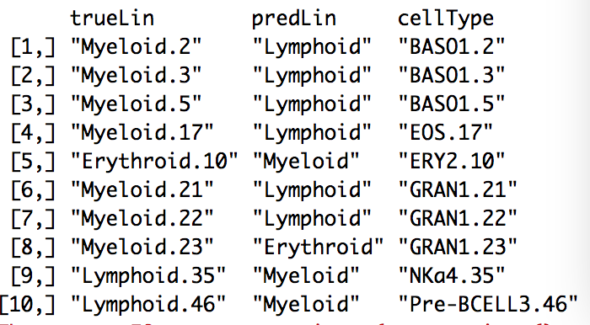
Metabolic Genes/ Megs + PDCs Filtered *
AUC: .9412
 | Erythroid | Lymphoid | Myeloid
Erythroid | 32 | 0 | 1 GRAN1.23
Lymphoid | 0 | 90 | 6 BASO1.2 BASO1.3 BASO1.5 EOS.17 GRAN1.21 GRAN1.22
Myeloid | 1 ERY2.10 | 2 NKa4.35 Pre-BCELL.46 | 31

Slide 34
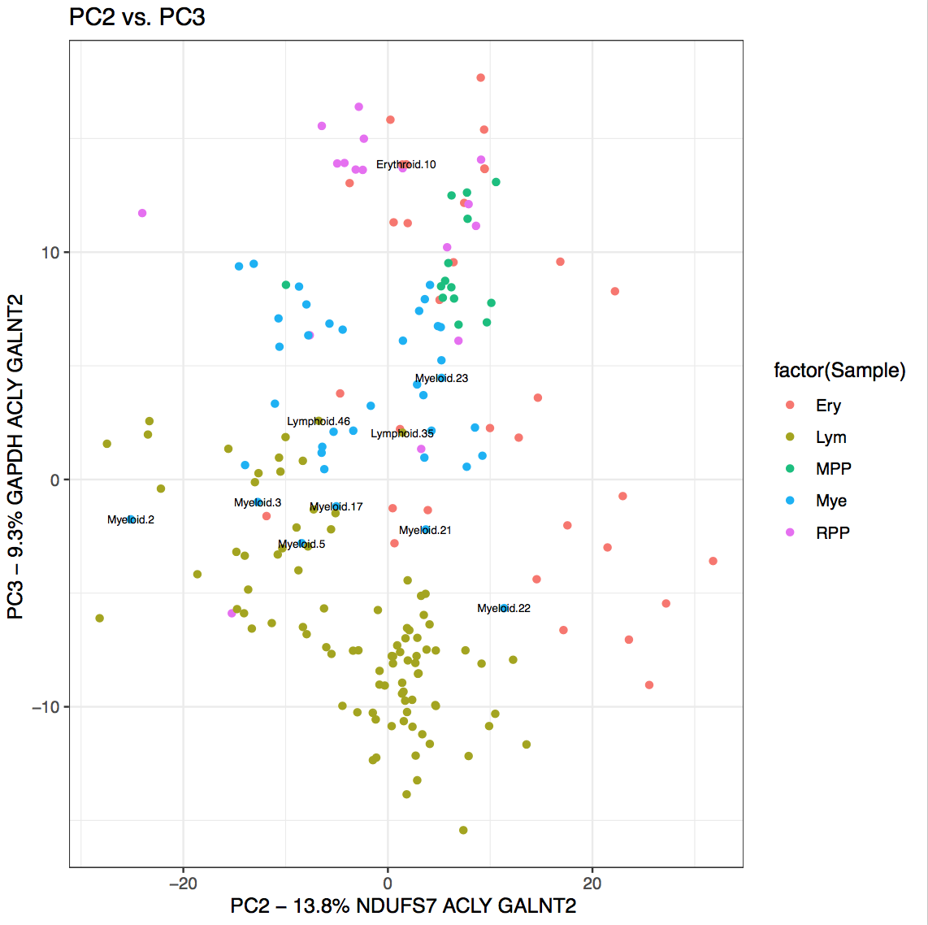
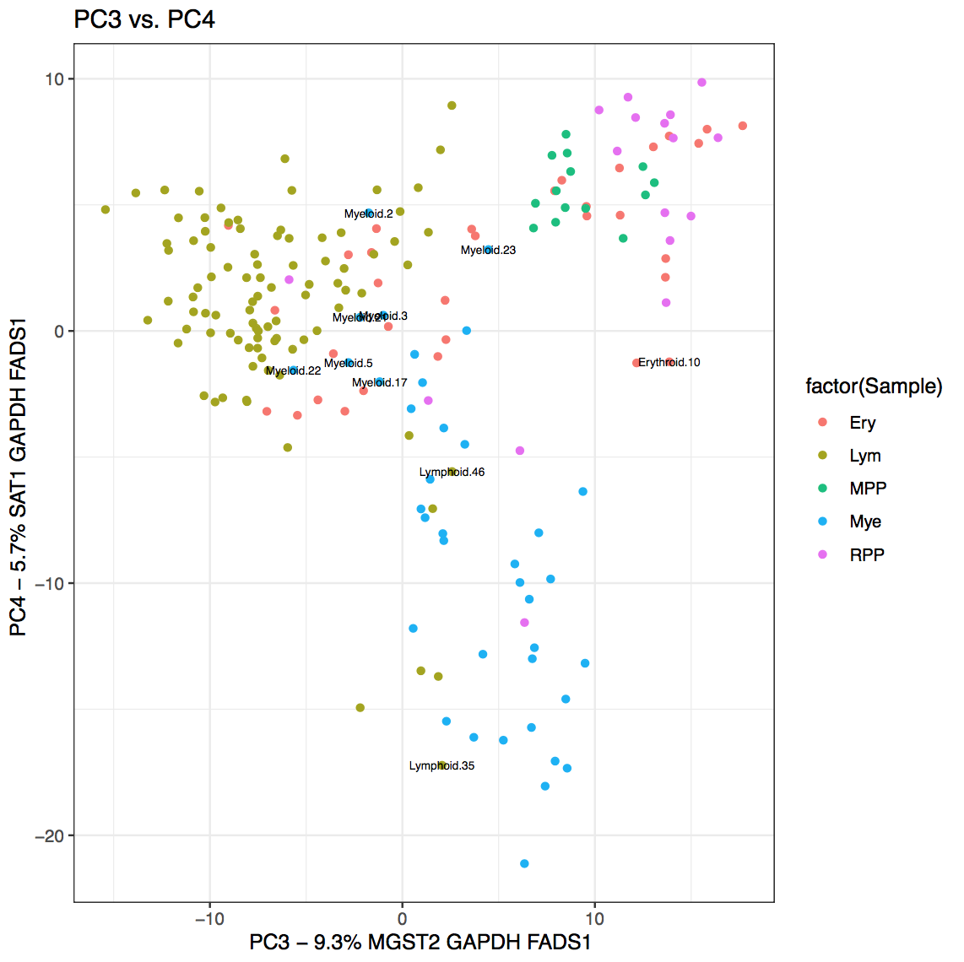

Slide 35
Upshot
We can try to perfect the model’s AUC for when, outside this experiment, we test on more multipotent cells (higher up Henry’s legs)
Principal Component Analysis compresses multidimensional data into 2D
We can use PCA charts to cross-verify cells that are uncharacteristically like themselves

Slide 36
Outline for Today
Define our problem
Processing: Data
Application: Machine Learning
Filtering
Gene Output + Code Sample
Conclusions/Discussion

Slide 37
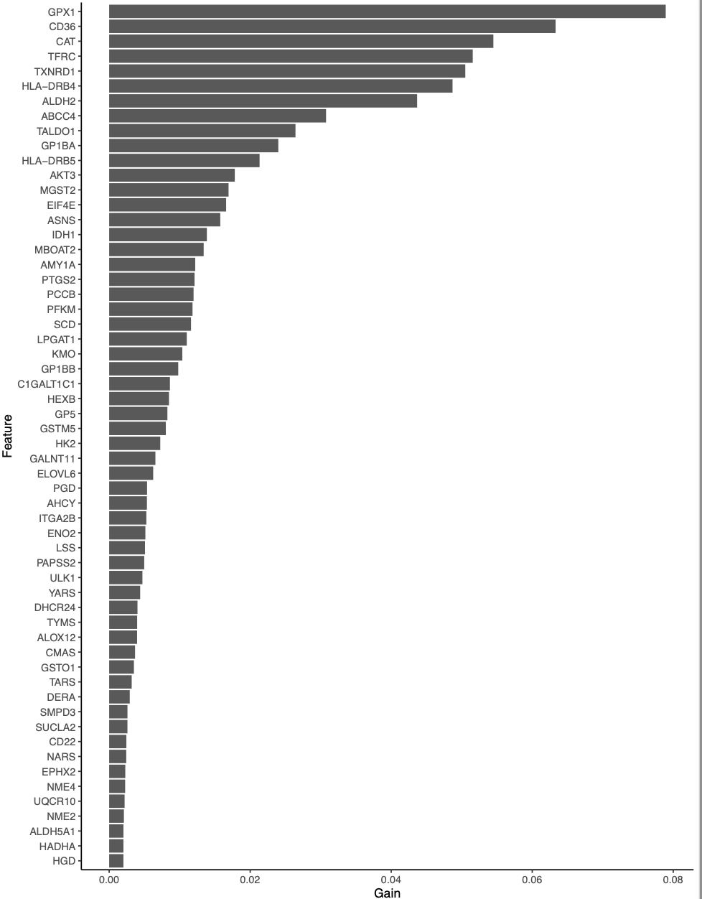
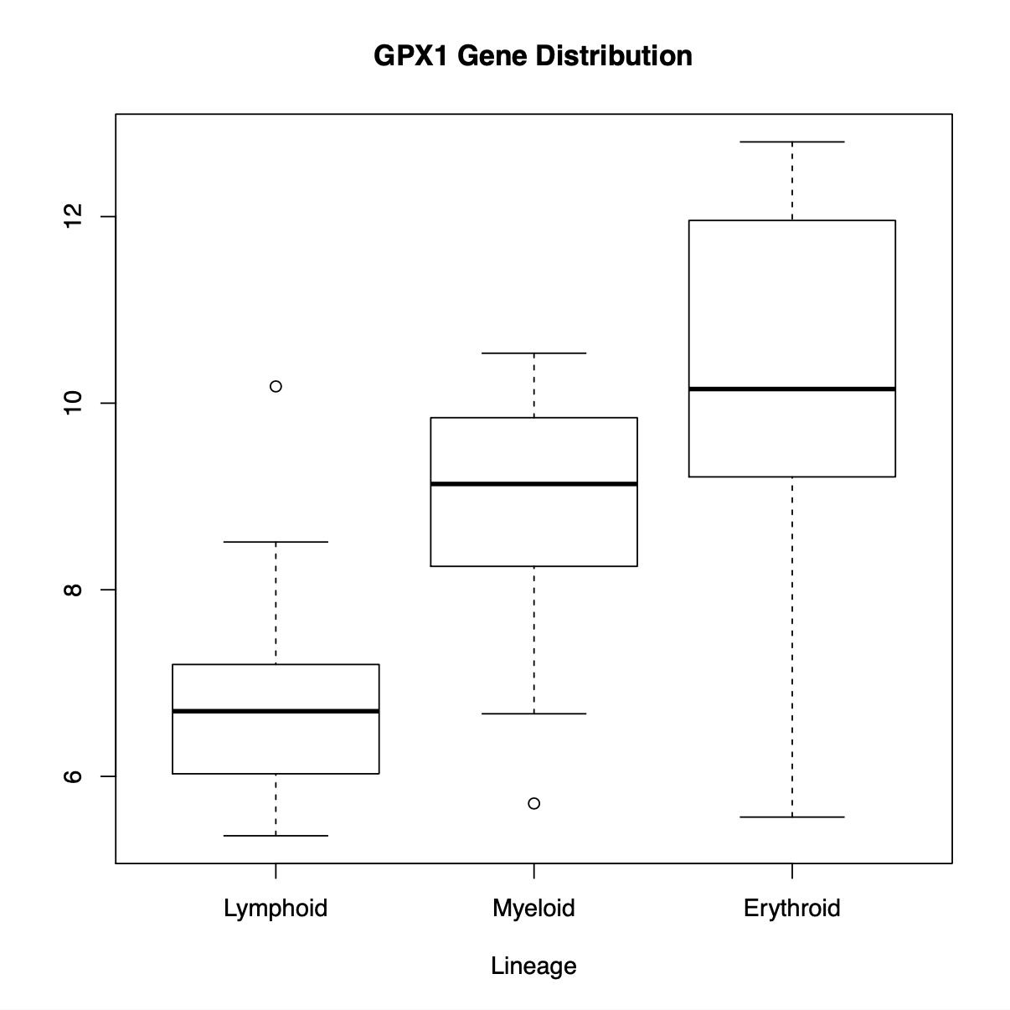
Top Genes used by Gradient Boost
*no Tukey test
Notes:
Tukey Test

Slide 38
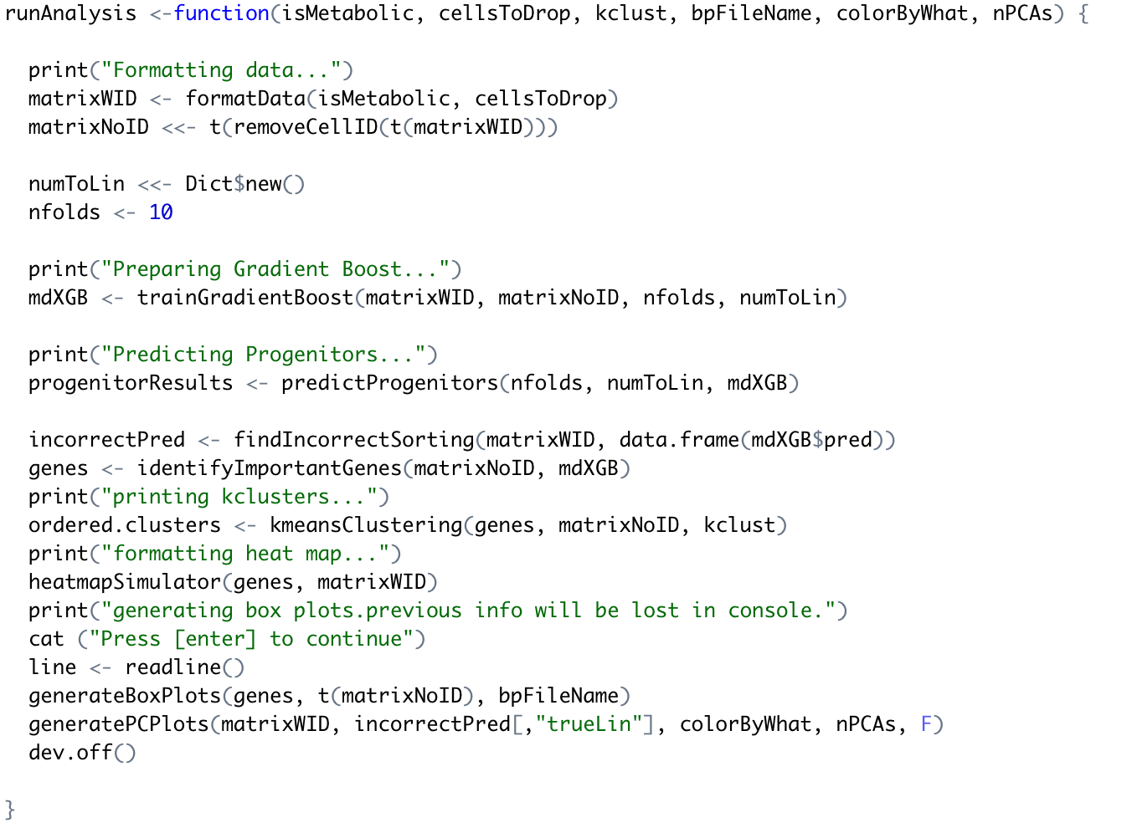
Notes:
A function should never be wider than your hand

Slide 39
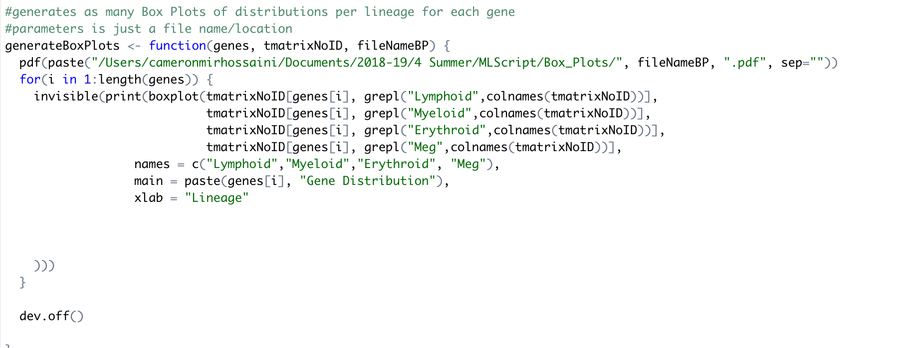
A function should never be wider than your hand

Slide 40
Top Genes per Lineage
Top Hits, best cluster
Least Hits, worst cluster
Erythroid
Glutathione Peroxidase (GPX1)
Transaldolase 1 (TALDO1)
Catalase (CAT)
Myeloid
Aldehyde Dehydrogenase 2 (ALD2)
Histocompatibility Complex (HLA-DRB4)
Hexokinase 2 (HK2)
Lymphoid
Amylase Alpha 1A (AMY1A)
Polypeptide N-Acetylgalactosaminyltransferase 11 (GALNT11)
3'-Phosphoadenosine 5'-Phosphosulfate Synthase 2 (PAPSS2)

Slide 41
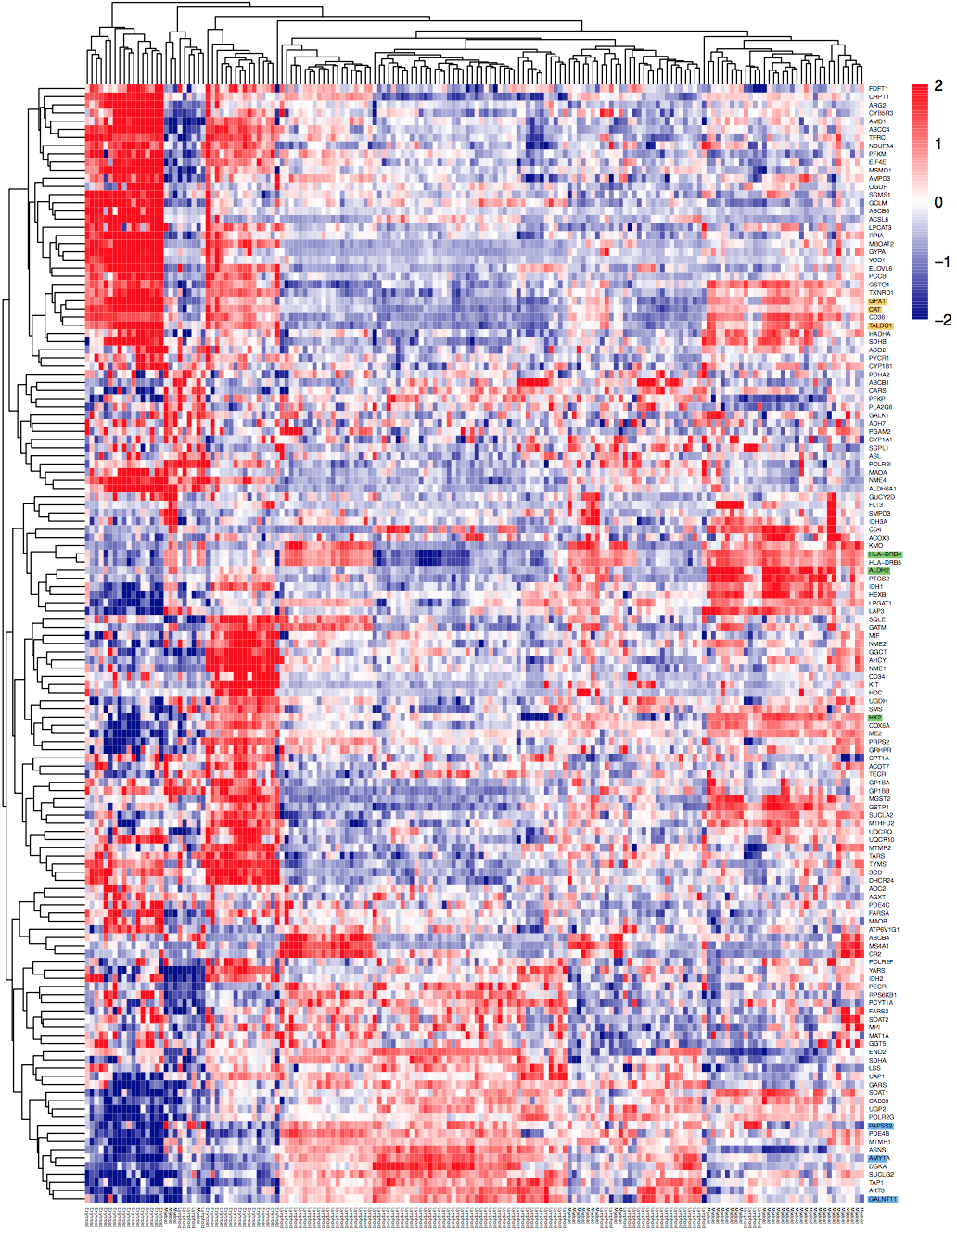
Figure 6; heat map of metabolic genes, PDC's and Megakaryocytes filtered Yellow genes are highly expressed in erythroid lineage Green genes are highly expressed in myeloid lineage Blue genes are highly expressed in Lymphoid lineage

Slide 42
Upshot
The Gradient Boost Algorithm gave us the top genes it used to sort cells
We can use boxplots and heat maps to verify which cell-type correlates with high OR low expression of which gene
This output can help guide wet lab experiments in the future
Ex: would high GPX1 expression in an HSC result in an erythroid cell?
We have a few levels left to continue testing (travel up toward Henry’s head)

Slide 43
Outline for Today
Define our problem
Processing: Data
Application: Machine Learning
Filtering
Gene Output
Conclusions/Discussion

Slide 44
Hypothesis
Metabolism is a key regulator in Hematopoietic stem cell differentiation in humans
Conclusion
Not rejected:
Algorithmic focus on Erythroid Cells
Looking at Progenitor Cells, not Stem Cells
Correlative, not causative
Notes:
If a metabolic pathway gave rise to lineages, there would be some genes that relate only to specific lineages evident early on (correlative)

Slide 45
Compelling Results for Early Stages
True Cell Type | Algorithm Prediction
GMP | Myeloid | ✅
GMP | Myeloid | ✅
GMP | Myeloid | ✅
GMP | Erythroid | ⛔️
MEP | Erythroid | ✅
MEP | Erythroid | ✅
MEP | Erythroid | ✅
MEP | Erythroid | ✅
MEP | Erythroid | ✅
MEP | Erythroid | ✅
MEP | Erythroid | ✅
MEP | Erythroid | ✅
MEP | Erythroid | ✅
Notes:
Label figure better

Slide 46
Takeaways
Data and mathematics are just one way man attempts to order the universe
Different algorithms will give different results (k-clusters vs. heat map)

Slide 47
Next Steps
Find Larger Datasets for better training
Wet Lab Experiments: run script on HSC’s and verify via wet lab tracking
Up/downregulate metabolic genes in HSC’s

Slide 48
Questions?

Slide 49
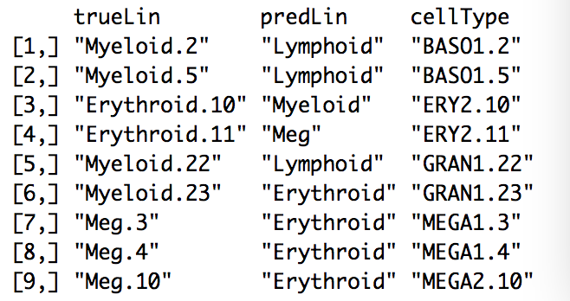
All Genes/No Filter *
 | Erythroid | Lymphoid | Meg | Myeloid
Erythroid | 31 | 0 | 3 MEGA1.3 MEGA1.4 MEGA2.10 | 1 GRAN1.23
Lymphoid | 0 | 92 | 0 | 3 BASO1.2 BASO1.5 GRAN2.22
Meg | 1 ERY2.11 | 0 | 9 | 0
Myeloid | 1 ERY2.10 | 0 | 0 | 39
AUC: .8936

Slide 50
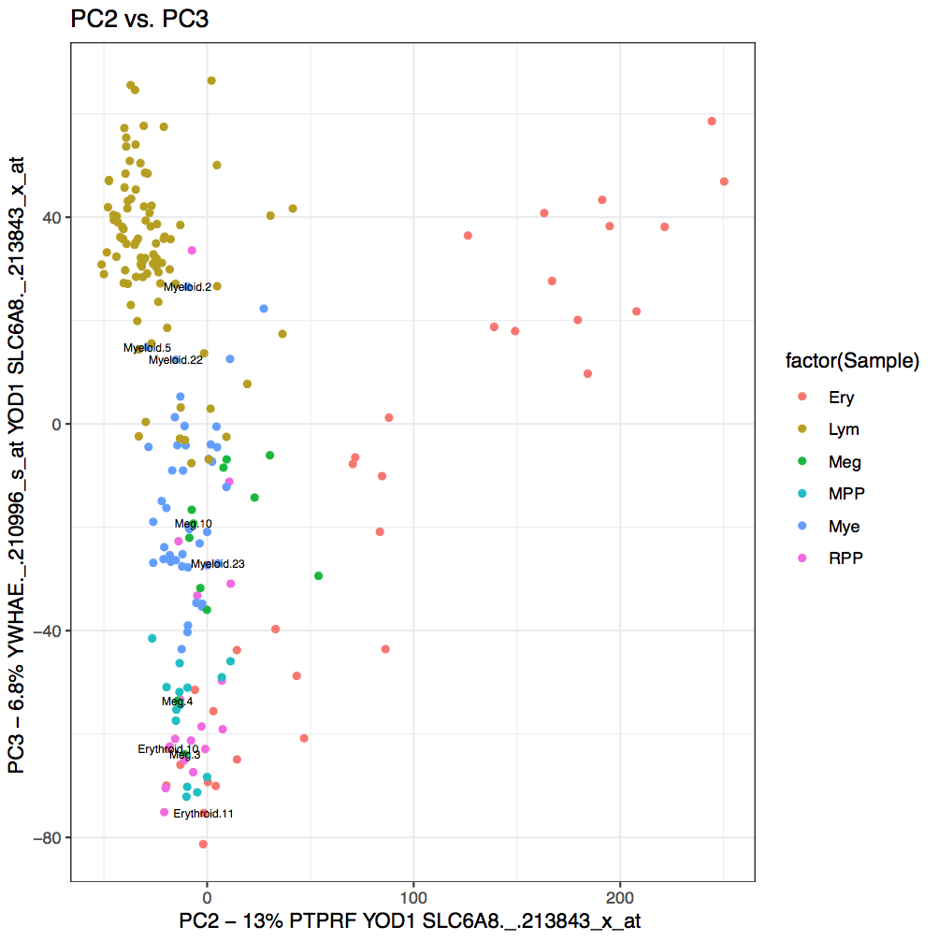
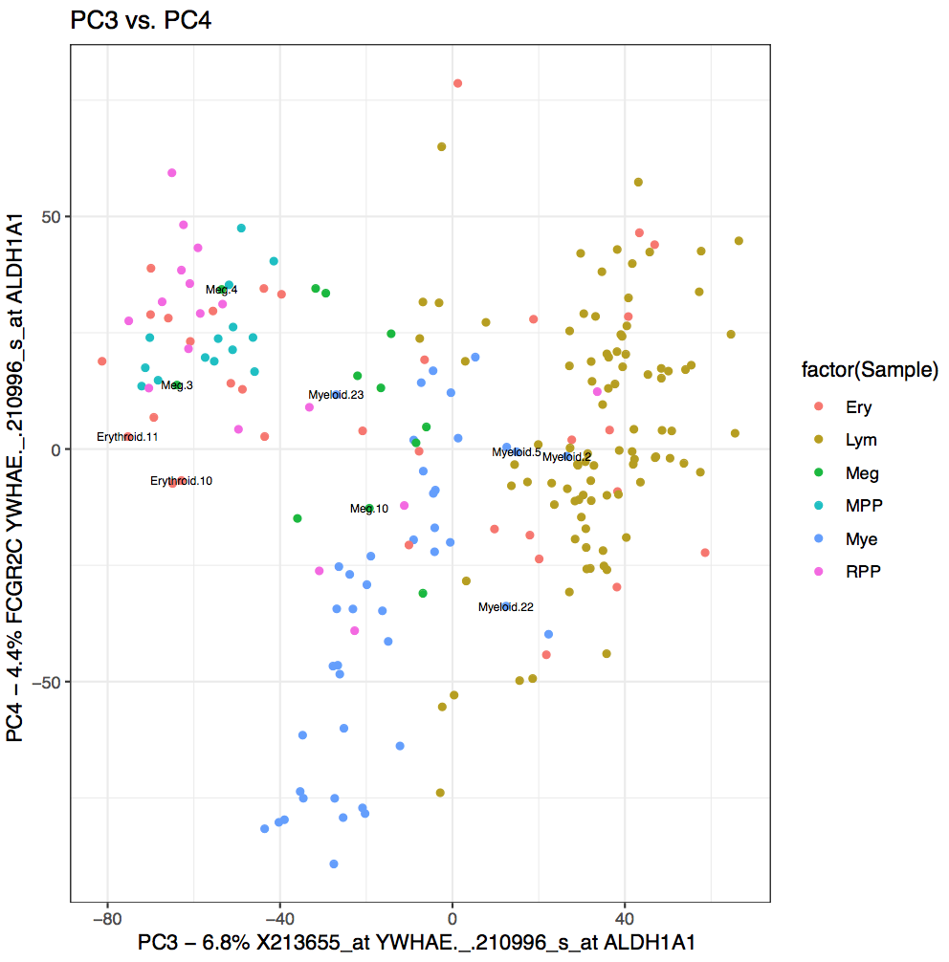

Slide 51
Metabolic Genes/No Filter *
 | Erythroid | Lymphoid | Meg | Myeloid
Erythroid | 31 | 0 | 2 MEGA1.3 MEGA1.4 | 1 GRAN1.23
Lymphoid | 0 | 89 | 0 | 4 GRAN1.21 GRAN2.22 BASO1.2 EOS.17
Meg | 0 | 0 | 8 | 0
Myeloid | 2 ERY2.7 ERY2.10 | 3 Nka1.23 Pre-BCELL2.41 Pre-BCELL2.46 | 2 MEGA1.2 MEGA2.5 | 38
AUC = .8854

Slide 53
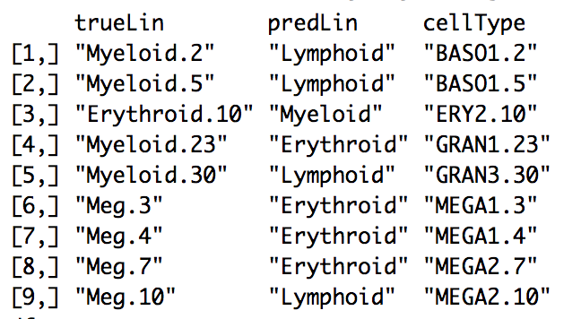
All Genes/PDC Filtered
 | Erythroid | Lymphoid | Meg | Myeloid
Erythroid | 32 | 0 | 3 MEGA1.3 MEGA1.4 MEGA2.7 | 1 GRAN1.23
Lymphoid | 0 | 92 | 1 MEGA2.10 | 3 BASO1.2 BASO1.5 GRAN3.30
Meg | 0 | 0 | 8 | 0
Myeloid | 1 ERY2.10 | 0 | 0 | 34
AUC = .892

Slide 54
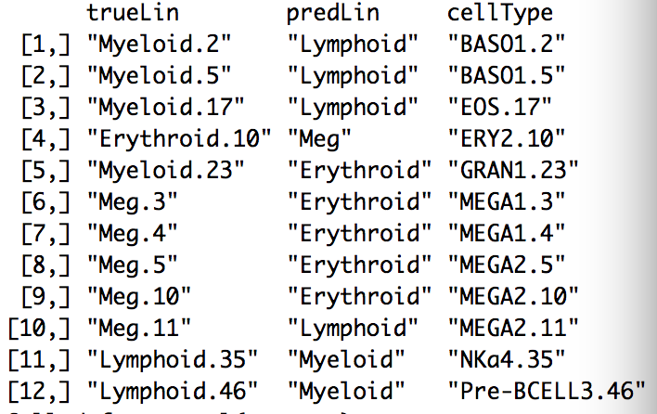
Metabolic Genes/PDC Filtered
 | Erythroid | Lymphoid | Meg | Myeloid
Erythroid | 32 | 0 | 4 MEGA1.3 MEGA1.4 MEGA1.5 MEGA1.10 | 1 GRAN1.23
Lymphoid | 0 | 90 | 1 MEGA2.11 | 3 BASO1.2 BASO1.5 EOS.17
Meg | 1 ERY2.10 | 0 | 7 | 0
Myeloid | 0 | 2 Nka4.35 Pre-BCELL3.46 | 0 | 34
AUC = .8725

Slide 55
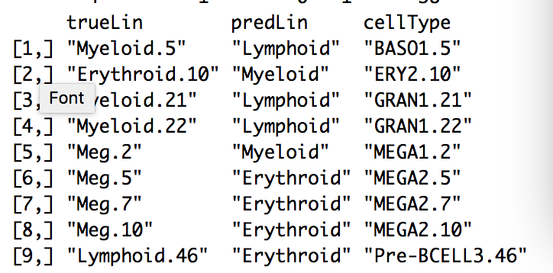
Metabolic Genes/Filtered Meg.3 Meg.4 Myeloid.2 Myeloid.23
 | Erythroid | Lymphoid | Meg | Myeloid
Erythroid | 32 | 1 Pre-BCELL3.46 | 3 MEGA2.5 MEGA2.7 MEGA2.10 | 0
Lymphoid | 0 | 91 | 0 | 3 BASO1.5 GRAN1.21 GRAN1.22
Meg | 0 | 0 | 6 | 0
Myeloid | 1 ERY2.10 | 0 | 1 MEGA1.2 | 38
AUC: .8903

Slide 56
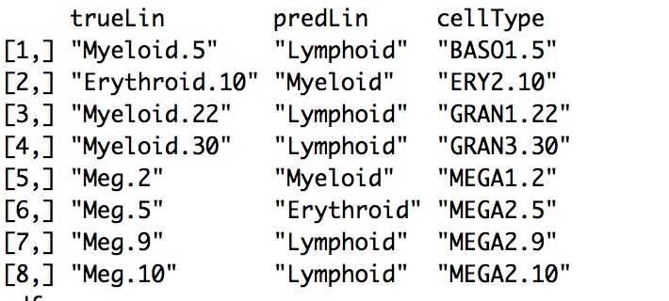
All Genes/Filtered Meg.3 Meg.4 Myeloid.2 Myeloid.23
 | Erythroid | Lymphoid | Meg | Myeloid
Erythroid | 32 | 0 | 1 MEGA2.5 | 0
Lymphoid | 0 | 92 | 2 MEG2.9 MEG2.10 | 3 BASO1.5 GRAN1.22 GRAN3.30
Meg | 0 | 0 | 6 | 0
Myeloid | 1 ERY2.10 | 0 | 1 MEGA1.2 | 38
AUC .9225

Slide 57
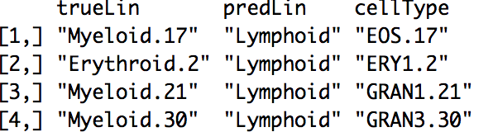
Metabolic Genes/Megs + Myeloid.2,Myeloid.5 Myeloid.22, Myeloid.23, Erythroid.10, Lymphoid.46
AUC: .9816
 | Erythroid | Lymphoid | Myeloid
Erythroid | 32 | 0 | 0
Lymphoid | 1 ERY1.2 | 90 | 3 EOS.17 GRAN1.21 GRAN3.30
Myeloid | 0 | 0 | 36

Slide 58
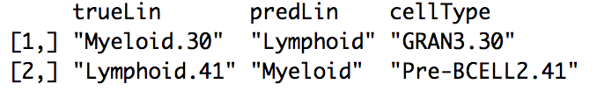
All Genes/Megs + Myeloid.2,Myeloid.5 Myeloid.22, Myeloid.23, Erythroid.10, Lymphoid.46
AUC: .9939
 | Erythroid | Lymphoid | Myeloid
Erythroid | 32 | 0 | 0
Lymphoid | 0 | 90 | 3 GRAN3.30
Myeloid | 0 | 1 Pre-BCELL2.41 | 38

Slide 59
